Slide 1
Project Planning Processes
1

Slide 2
Contents
About Project Planning
Software Project Manager
Project Planning Process
Recourses used in Project Development
1

Slide 3
About Project Planning
Before starting a software project, it is essential to decide which tasks to be performed and how to manage all tasks involved in the software development.
Project planning is an organized process from requirement gathering to testing and support.
Focuses on all activities required for successful completion of the project.
Prevents obstacles that arise in the project such as changes in projects, organization's objectives, non-availability of resources and so on.
Helps in better utilization of resources and optimal usage of the allotted time for a project.
Defines roles and responsibilities of the project management team members.
1

Slide 4
Software Project Manager
Managing People
Act as Project Leader.
Contact with all stakeholders.
Managing human resources.
Managing Project
Defining and setting up project scope.
Managing project management activities.
Monitoring progress and performance.
Risk analysis at every phase.
Take necessary step to avoid or come out of problems.
1

Slide 5
Software Project Manager
Managing People
Act as Project Leader.
Contact with all stakeholders.
Managing human resources.
Managing Project
Defining and setting up project scope.
Managing project management activities.
Monitoring progress and performance.
Risk analysis at every phase.
Take necessary step to avoid or come out of problems.
1

Slide 6
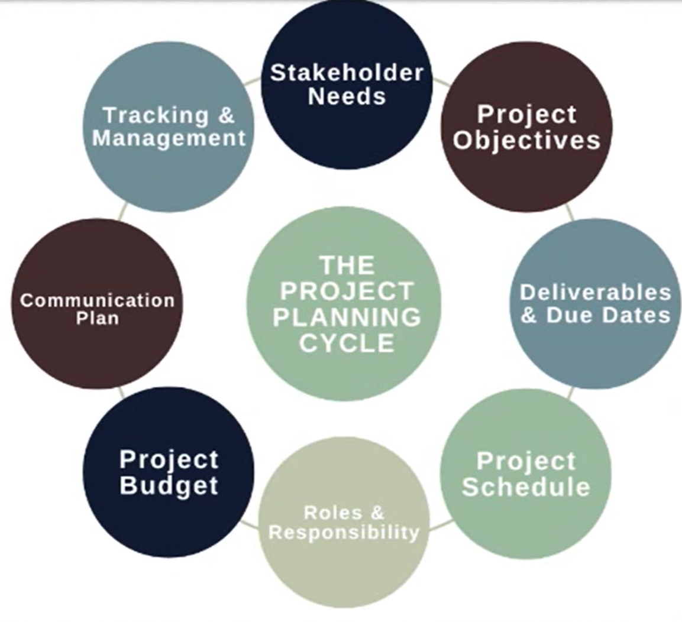
Software Project Manager
1

Slide 7
Project Planning Process
Identify Stakeholders Need:
A project must meet the expectations of stakeholders & meet all of their needs to be effective.
To consider their needs a project planner might identify the characteristics and qualities of the project at hand.
2. Identify Project Objectives:
Project objectives must be specific, measurable, achievable, realistic and time-bound in order to be used to validate project success.
All team members must contribute ideas and compromise on collective goals for the project.
1

Slide 8
Project Planning Process
3. Identify Deliverables & Due Date:
A due date is a scheduled fixed date and time that an objective is due within a project.
Deliverables are defined as the products, services or results that project quality, size, length, or any other standard that proves to be important in the success of project.
4. Identify Project Schedules:
This stage is created through different tasks that label a project's start and end date.
Schedules are used to make sure projects stay on task and are completed in a timely manner.
1

Slide 9
Project Planning Process
5. Provide Roles & Responsibilities:
This stage allows for effective communication between everyone involved in the project.
This segment includes identifying who is involved and what their individual tasks are.
Everyone understand expected objectives, goals & output of project.
6. Identify Project Budget:
Project budget are calculating the anticipated cost, changing budget cost and monitoring the budget.
Therefore, it is crucial to prepare for unexpected alterations of project costs.
1

Slide 10
Project Planning Process
7. Identify Communication Plan:
A communication plan is a tool that able to effectively communicate about a project to your client, team and other stakeholders.
Communication plan has clear guidelines about how information will be shared & who is responsible within the project.
8. Provide Tracking & Management:
It is an effective way to deliver projects on time and organize tasks.
Features of this element include planning/scheduling, collaboration, documentation and evaluation.
Management tools are track productivity and growth of project.
1

Slide 11
Recourses Used in Project Development
Project resources simply mean resources that are required for successful development and completion of project on time and on budget.
Type 1: Human Recourses
In software industry, manager, software developer, software testing and so on.
These positions are according to their skills and specialty.
Type 2: Reusable Components
Managing budget for project is one of most important tasks that all project managers.
The reusable resources are very helpful as they help in reducing overall cost of development.
Type 3: Hardware and Software tools
It should be planned before starting development of project otherwise it way causes problems.
These are actually material resources that are part of project.
1

Slide 12
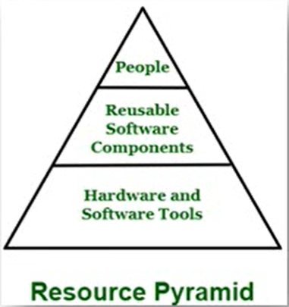
Recourses Used in Project Development
1

Slide 13
Project Scope Management
1

Slide 14
Project Scope Management
Scope refers to the detailed set of deliverables or features of a project.
This includes all the objectives, activities, process, output, deadline need to be done in order to make a deliverable software product.
Scope management is essential because it creates boundaries of the project by clearly defining what would be done in the project and what would not be done.
1

Slide 15
Real Life Example of Project Scope Management
‘I need a new house’, & no one has any idea about functionality of the house at this point.
Should it be Apartment or an Independent house?
How many rooms, swimming pool, car park, security, air conditioning the scope gets elaborated as the project progresses.
Scope which has major impact on the architecture, budget of the project need to be fixed before we commence the detailed planning.
The purpose of ‘Project scope management’ is to ensure that the project includes all the work required and exclude all the unwanted work during the beginning till the end of the project.
1

Slide 16
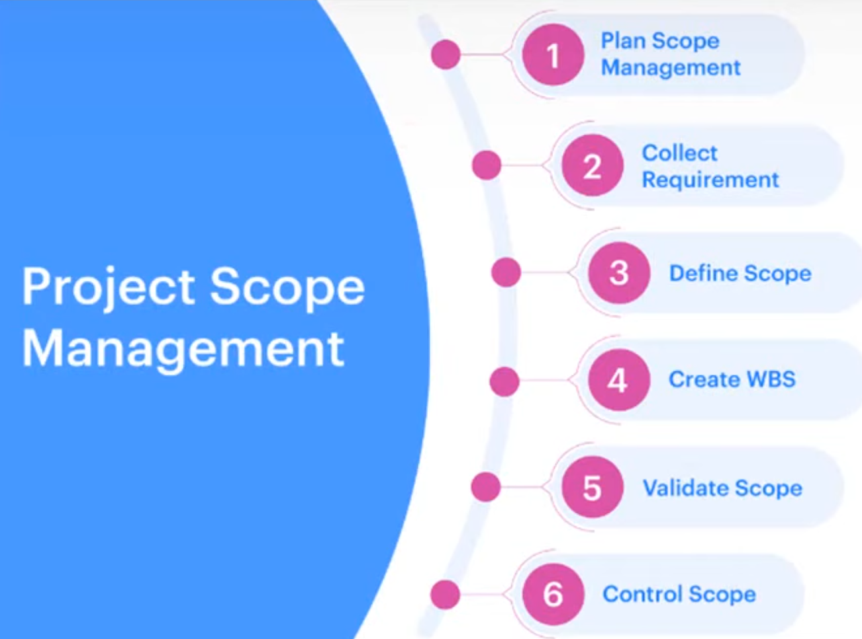
Project Scope Management
1

Slide 17
Work Breakdown Structure
1

Slide 18
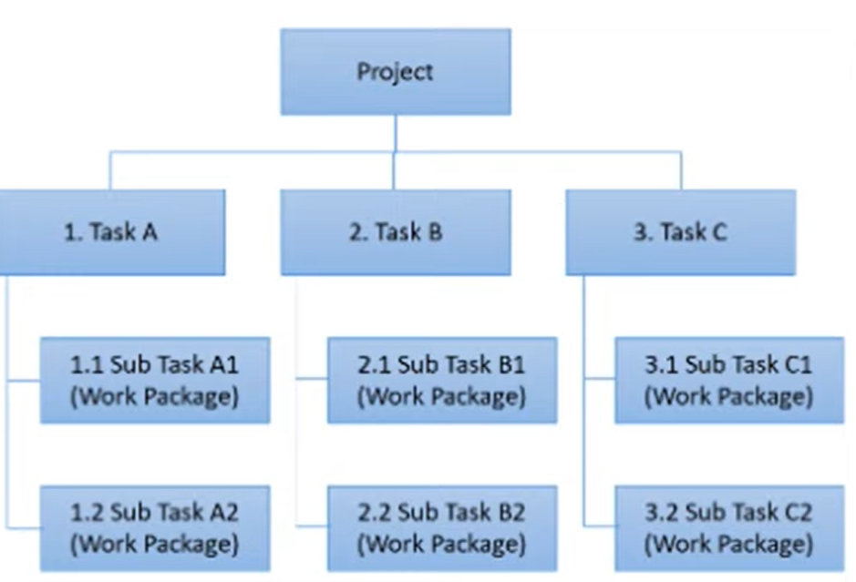
Work Breakdown Structure
1

Slide 19
Work Breakdown Structure
A Work Breakdown Structure includes dividing a large and complex project into simpler, manageable and independent tasks.
It used to organize and plan projects, programs and portfolio.
It follows a Top-Down & Hierarchical view approach.
The root of this tree is labelled by the Project name itself.
Perform by Project Manager & Subject Matter Expert.
1

Slide 20
Working of Work Breakdown Structure
Step 1: Project managers decide project name at top / root of WBS.
Step 2: Project managers identifies the main deliverables of the project.
Step 3: These main deliverables are broke down into smaller higher-level tasks.
Step 4: This complete process is done recursively to produce much smaller independent tasks.
Step 5: Choose Task Owner. They need to get the job done.
Depends on project manager that up to which level of detail they want to break down project.
Lowest level tasks are most simplest & independent tasks it takes less than weeks of work.
1

Slide 21
Components of Work Breakdown Structure
WBS Dictionary: Document that defines the various WBS elements.
WBS Levels: Determines the hierarchy level of a WBS element.
Task: Main deliverable tasks. Status, Description, Task owner, Dependencies and Duration.
Sub Task: Divided tasks of Main deliverable tasks.
Work Packages: Lowest level of WBS. Small group of tasks.
Control Account: Group work packages and measure their status.
Project Deliverables: Desired outcome of project tasks and work packages.
1

Slide 22
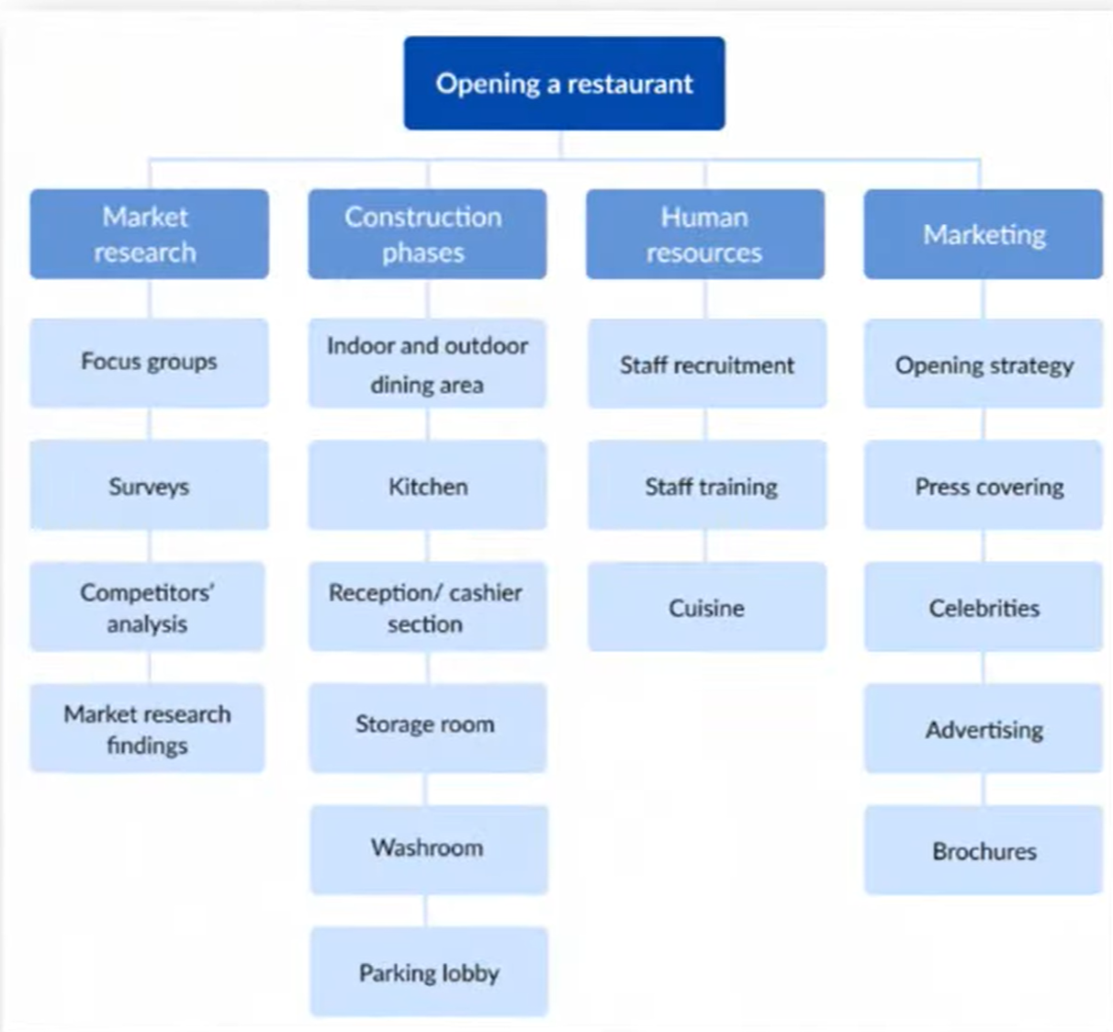
Example-01
1

Slide 23
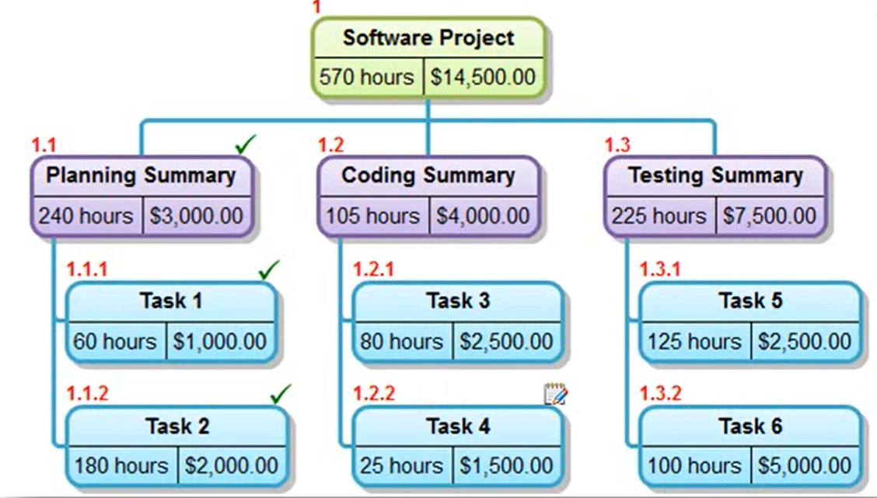
Common WBS Software tools
Many free and paid software tools can help you create WBS for your projects
Common WBS Software tools are:
EdrawMax
Lucidchart
SmartDraw
Visual Paradigm
MindView
Creately
1

